Slide 1
ITU COE APAC 4th Steering Committee Meeting 14 Dec 20
Training Implementation Report 2020 &
Training Plan 2021
Presented by: Dr. Leow C. Y. (Bruce) Wireless Communication Centre, UTM

Slide 2
Training Implementation Report 2020
Fifth Generation (5G) Radio Access Network Planning and Technology Coexistence
Human Exposure to Radio Frequency Electromagnetic Fields

Slide 3
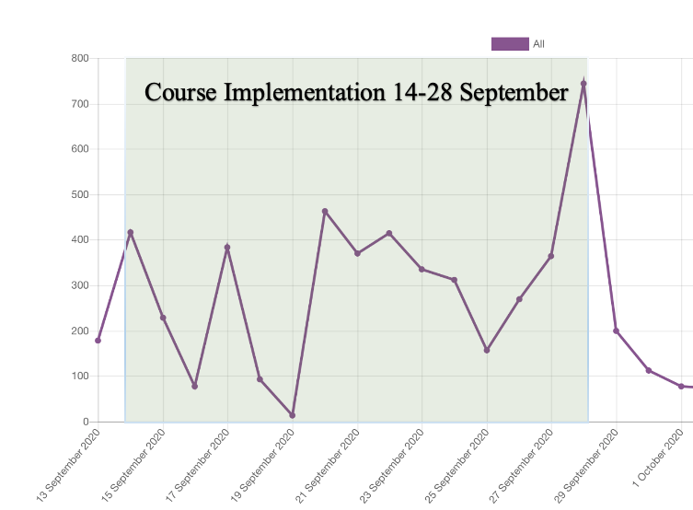
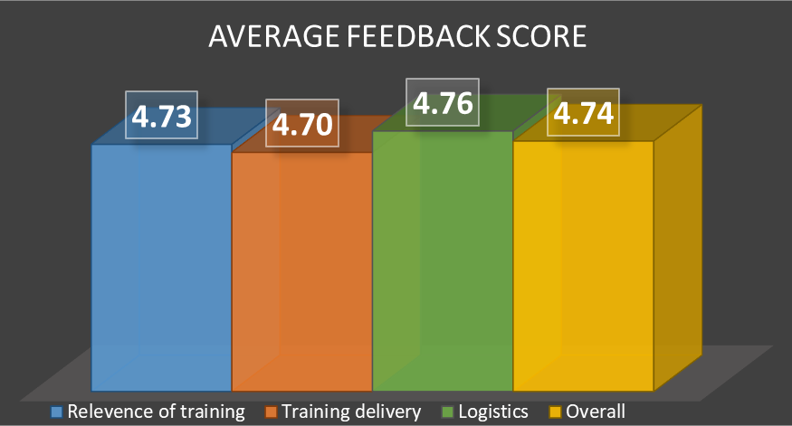
1. FIFTH GENERATION (5G) RADIO ACCESS NETWORK PLANNING AND TECHNOLOGY COEXISTENCE
14-28 Sep 2020
ITU Academy & Webex
18 hours live lectures
19 Participants
Traffic of e-learning course page
18/19 Pass (95%)
53%
47%
Snapshots of the live lecture sessions
53%
47%
Course feedback
Participants Distribution:
No. of participants that completed the training : 19 pax
No. of male participants : 10 pax
No. of female participants : 9 pax
No of international participants : 9 pax
No of local participants : 10 pax
No of industry participants : 11 pax
No of academia participants : 8 pax
Notes:
Participation
This course achieves a well-balanced participation from local and international participants. Specifically, this course is attended by 53% local participants and 47% international participants. Overseas participations are from Canada (1), India (1), United Kingdom (1), Qatar (1), Afghanistan (1), Australia (1), Thailand (1), Kenya (1) and Indonesia (1). From 19 participants who attended the online training, 58% were from the industry and 42% were from academia.
Assessment
The overall passing rate is 95%, where 18 out of 19 participants were eligible for certificates.
Feedback
The online training received excellent feedback from the participants in terms of relevance & training, training delivery, logistics and overall. The average score is above 4.70 (94%) for all categories.

Slide 4
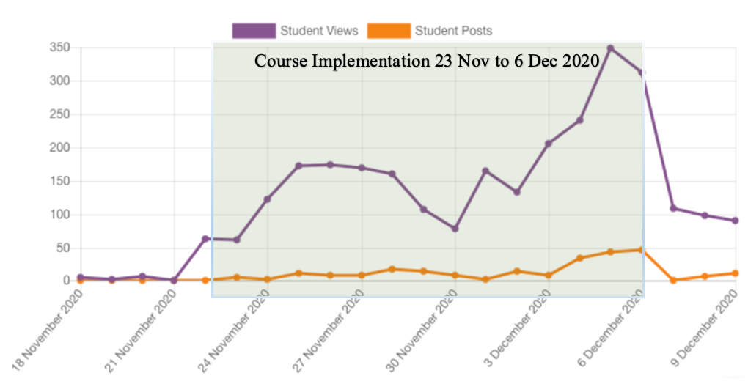
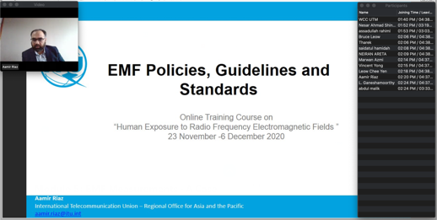
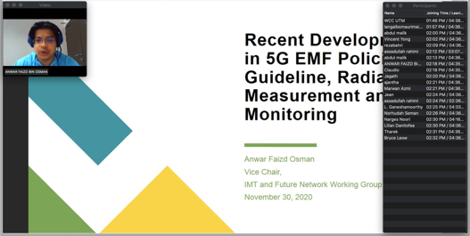
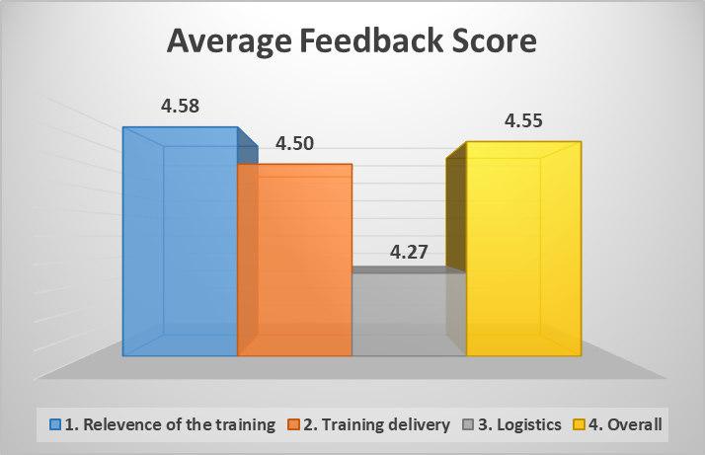
2. HUMAN EXPOSURE TO RADIO FREQUENCY ELECTROMAGNETIC FIELDS
23 Nov-6 Dec 2020
ITU Academy & Webex
17 hours live lectures
16 Participants
Traffic of e-learning course page
10/16 Pass (62.5%)
12%
88%
75%
25%
Course feedback
Snapshots of the live lecture sessions
Participants Distribution:
No. of participants that completed the training : 19 pax
No. of male participants : 10 pax
No. of female participants : 9 pax
No of international participants : 9 pax
No of local participants : 10 pax
No of industry participants : 11 pax
No of academia participants : 8 pax
Notes:
Participation
The training course was attended by 16 participants. The distribution of the participants are listed below and the full list of participants is shown in Table 1.
Participants Distribution:
This course is attended by 12% local participants and 88% international participants. Overseas participations are from Canada (1), Sri Lanka (3), Vanuatu (2), Solomon Islands (1), Afghanistan (5), Kiribati (2), and Malaysia (2). From 16 participants who attended the online training, 88% were from the industry and 12% were from academia.
Assessment
The overall passing rate is 62.5%, where 10 participants were eligible for certificates.
Feedback
The online training received a good feedback from the participants in terms of relevance & training, training delivery and overall. The average score is above 4.47 (89%) for all categories. See Figure 3.

Slide 5
Training Plan 2021
Fifth Generation (5G) Implementation: Practices and Case Studies
Human Exposure to Fifth Generation (5G) Electromagnetic Fields: Guidelines, Measurements &
Case Studies

Slide 6
1. Fifth Generation (5G) Implementation: Practices and Case Studies
Week 1 | Week 2
1. 5G Technology Review | 6. Network Deployment Strategies
2. 5G Implementation Challenges | 7. 5G KPI Measurements and Benchmarking
3. Spectrum Pricing | 8. Public acceptance of 5G roll-out
4. Spectrum Sharing | 9. Commercial use cases success stories
5. Infrastructure Sharing | 10. Operators’ Case Study and Lessons Learn
Date: 5 – 18 April 2021
ITU Academy & Webex
Live lectures & case studies
USD 300

Slide 7
2. Human Exposure to Fifth Generation (5G) Electromagnetic Fields: Guidelines, Measurements & Case Studies
Week 1 | Week 2
1. Fundamental of Base Stations and Devices EMF Emission | 6. On-site EMF Measurement
2. Key 5G Radio Technology and EMF Emission | 7. 5G EMF Measurement Case Study in Malaysia
3. 5G EMF Policies, Guidelines and Standards | 8. 5G EMF Measurement Case Study in Switzerland
4. EMF Lab Measurement | 9. EMF Monitoring Case Study
5. EMF Simulation | 10. Public Education on5G EMF Exposure and Public Health Concerns
Date: 16 – 29 Aug 2021
ITU Academy & Webex
Live lectures & case studies
USD 300

