Slide 1
INTERNATIONAL CENTRE FOR INFORMATION & COMMUNICATION TECHNOLOGY STUDIES
TECHNOLOGY
INNOVATION
EDUCATION

Slide 2
FOUNDED in
2004
100%
OWNED BY
Notes:
Acknowledging the need to foster the rapid development and growth of the Information and Communication Technology (ICT) sector through capacity building and manpower development, the Digital Bridge Institute, the International Centre for Communications Studies (DBI), was conceptualized by the visionary Board of the Nigerian Communications Commission (NCC) in accordance with one of the Commission’s statutory mandate to assist industry stakeholders and practitioners with a view to the development of the industry.
The Board of the NCC translated its vision to action and the DBI was established in 2004, and commissioned by no less a personality than Chief Olusegun Obasanjo, GCFR, President and Commander-in-Chief of the Armed Forces of the Federal Republic of Nigeria on May 20, 2004

Slide 3
NCC supports DBI to sustain membership of ITU CoE Network
NCC is represented on the Board of DBI by the EVC and the Commission’s Chairman.
NCC appoints the CEO of DBI
DBI operates as a training arm with its own Board and operating structure.
DBI-NCC Relationship
DBI was registered by NCC as a not-for-profit training institute in 2004 with mandate for ICT capacity building.
NCC provides intervention funds for ICT capacity building - ADAPTI, DAP etc.
NCC funds major CAPEX of DBI while the Institute is responsible for operating spending.

Slide 4
PROPOSED COURSES FOR 2021
1
EMERGING CYBERCRIME TRENDS:
CYBERCRIME INVESTIGATIONS AND MOBILE FORENSICS FOR SECURITY INTELLIGENCE, INVESTIGATORS & LAW ENFORCEMENT OFFICERS
2
CYBER SECURITY
CYBER FORENSICS AND IT RISK MANAGEMENT

Slide 5
1
PROPOSED COURSES FOR 2021
Social Media Analytics and Management
Entrepreneurship
&
Innovation
2
Virtual Communication & Infographics

Slide 6
1
PROPOSED COURSES FOR 2021
International Computer Driving Licence (ICDL) - workforce modules
ICT
Application
Section 3.1 “Delivery of training” Paragraph 3 of the Operational Processes and Procedures for the ITU Centres of Excellence Network (2018)

Slide 7
FACTORS IN OUR FAVOUR
PARTNERSHIPS WITH ITU, GSMA, NCC, IEEE
NEW CAMPUS FACILITIES
AFRICA NETWORK OF COEs
STABLE DEMOCRATIC ENVIRONMENT
STRATEGIC MANAGEMENT PLAN
EXPERT FACULTIES

Slide 8
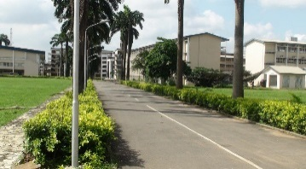
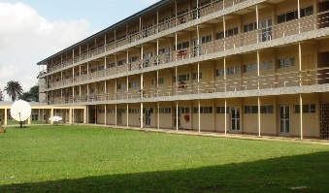
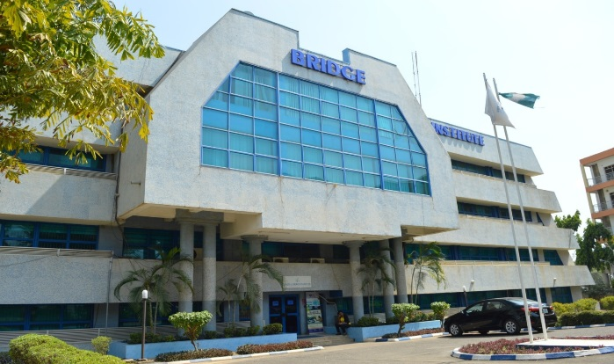
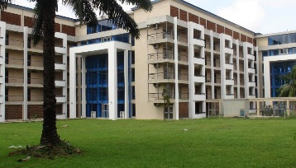
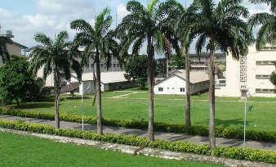
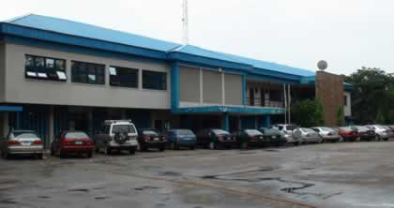
Campuses in 3 main locations
LAGOS
ABUJA
KANO
3 MORE TO FOLLOW – ASABA, ENUGU, YOLA

Slide 9
PARTNERS

Slide 10
www.dbi.edu.ng

