Slide 1
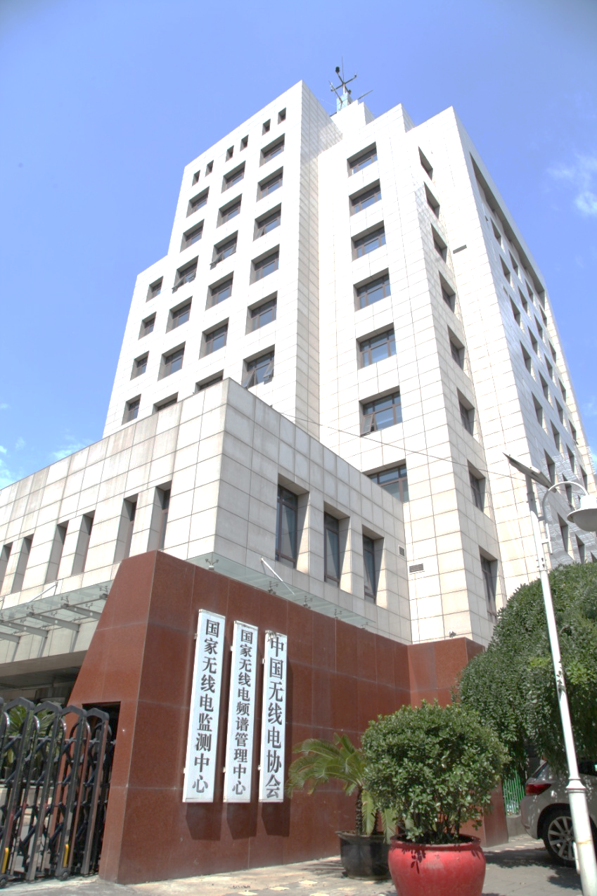
Report on the ITU CoE work
on Spectrum Management
State Radio Monitoring Center
Ministry of Industry and Information Technology

Slide 2
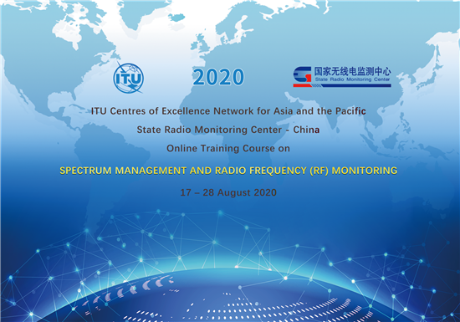
2020 (Online)
Online Training Course
Topic: Spectrum Management and Radio Frequency (RF) Monitoring
Date: 2 weeks, 17-28 August 2020
No. of participants: 359
No of international participants: 270 (from 61 countries)
No of national participants: 89 (including China and Hong-Kong)
60 mins with 15 mins for summary of relevant content and 45 mins for Q&A

Slide 3
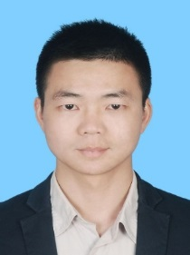
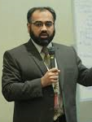
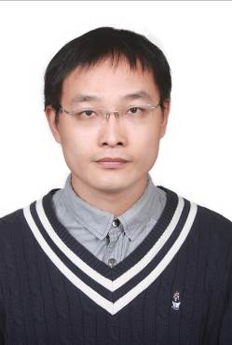
2020 (Online)
Spectrum Management and Radio Frequency (RF) Monitoring
Study activities in ITU-R Working Party 1C
Satellite monitoring and interference geolocation: Development & Challenges
Monitoring Techniques Based on Radio Sensors
Civil UAVs monitoring techniques
Data Acquisition and Processing Technology Based on Internet plus Radio Sensor
5G NR Downlink Signal OTA Measurement in the field
Outcomes of World Radio Conference 2019

Slide 4
2020 (online)
The overall assessment is made up of four components
170 participants qualified for the issuance of certificate
Equates to passing percentage: 47.4%
The workshop received excellent feedback from all participants. In summary, the topic and program were considered to be highly relevant and delivered by very knowledgeable expertsin a way that aided participation and learning.

Slide 5
2021 (Planned)
1st online training course
2nd online training course
Topic
Spectrum management and technology application
Date
July, 2021
Presentations
The course mainly focus on spectrum management and technology application, such as 5G spectrum management, IOT implementation, Spectrum management for railway radiocommunication and so on.
2 weeks
Topic
Spectrum Management and Spectrum engineering techniques
Date
2-3 weeks
Presentations
The course mainly focus on Spectrum Management and Spectrum engineering techniques, such as sharing study, technical spectrum efficiency, bilateral coordination, Earth-station coordination areas and so on.
September, 2021

Slide 6
Thanks
http://www.srrc.org.cn

