Slide 1
COE CITET Work plan for 2021
Realised in December 09, 2020
by Jawhar Abdelkrim

Slide 2
Abstract
ICT play a key role in protecting and maintaining the environment and it is also the first way to deal with the COVID 19 pandemic. Therefore, in 2021, CITET aims to develop more training sessions on line combining environmental fields with ICT tools and will work to provide incentives to support the efforts of governments, civil society and international organizations working to minimize the sources of pollution poverty and stigma.

Slide 3
CITET Target
With the assistance of ITU , the CITET wants to play the role of a training platform capable of mobilizing resources for the development of the skills of local and regional operators, making it possible to better identify the region's commitments in all areas of mitigation and adaptation to the harmful impacts of climate change and in particular capacity building for a better future for all our peoples.

Slide 4
CITET realization in 2020
Du to the Covid 19 pandemic the work plan of CITET was destroyed and all the planning was changed with the help and recommendations of ITU direction.
CITET has revised their courses and has migrated from face to face to online courses us recommended. Unfortunately, the realization was very poor.
In 2020 CITET accomplished just one face to face course from 07 to 10 September 2020 with the participation of 7 local members.

Slide 5
Evaluation
The CITET was confronted to familiarize itself with the on line courses but the context, the social disturbance, the bad economic situation made the operation difficult and complex.
The target population was neither convinced nor interested in the courses,
The mobilization of experts has become different and requires another procedure ...
The ITU platform is not easily accessible.

Slide 6
Training sessions proposed in 2021
Application of GIS in environmental management and resources protection ( level 1)
Face-to-face courses from 08 to 11 february 2021 at CITET
Application of GIS in environmental management and resources protection (level 2)
Face-to-face courses from 13 to16 September 2021 at CITET
How to carry out a full life cycle assessment
Face-to-face course from 22 to 25 March 2021 at Hammamet 5* hotel
On line course, 05 sessions of 3 hours from 01 to 05 November 2021
How to Assess Your Products Carbon Footprint
Face-to-face courses from 24 to 27 May 2021 at Hammamet 5* hotel
On Line course, 05 sessions of 3 hours from 20 to 24 December 2021
Smart and sustainable cities
On line 05 sessions of 3 hours from 07 to11 June 2021
Environmental Impact Assessment
On line course 05 sessions of 3 hours 20 to 24 September2021
Face-to-face courses from 08 to11 November 2021

Slide 7
CITET training effects
By mastering the “eco-innovative” tools developed and linked to CC and/or ICT such as carbon footprint, life cycle analysis and management tools, CITET can be a focal point for the transfer of environmental technologies, to limit greenhouse gas emissions and preserve the legitimate right of all Arab countries to well-being, health, and sustainable development.

Slide 8
Remarks and recommendations
Maintain evolution in training and coaching in the fields of renewable energy, energy saving, Waste management, treatment of waste water, and eco-design.
Improving the events disseminations,
Assuring a minimum of foreign participants,
Ameliorating the booking services in the host country.

Slide 9
Marketing actions
Preparing a particular communication plan for each courses,
Use Customer needs in the elaboration of our training program,
In this way CITET target to update regularly her services presentation and improve the management of her customers by:
Update CITET public and private customer data,
Analyze the market by type of customer and region,
Inform daily our customers about our offer and news.
Exploitation of web site and social media
→ Promote and exibe services offered by publishing her programs and projects in her web site, in her facebook page and in the professional sites like LinkedIn and twitter

Slide 10
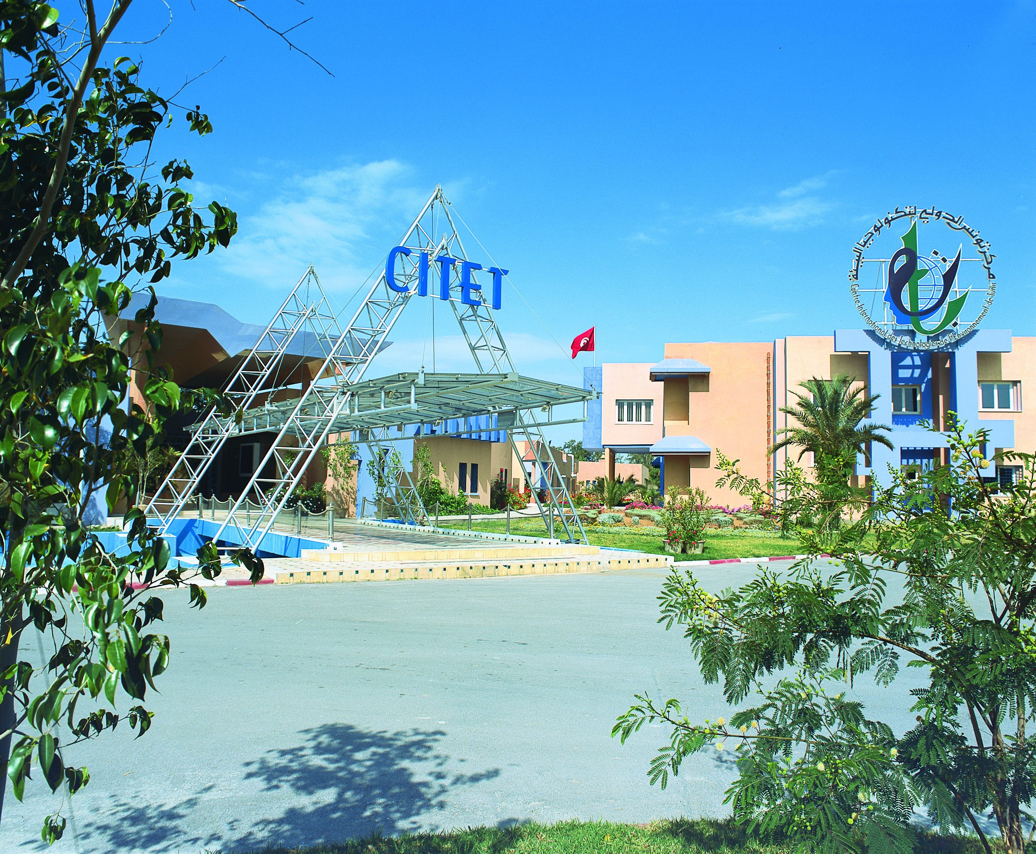
Thank You
For more details
Contact:
Mr Jawhar Abdelkrim
financement@citet.nat.tn
Tel: +216 51 429948

